Slide 1
AI-Based Forest Tree Detection, Mapping, and Decision Support System
Author: Muruththettuwa Gama Ethi Ralalaya Subhatha Kaumud Senanayake
Computer Science
Supervisor: Mc sc ing Maksims Žigunovs
April 2026

Slide 2
Introduction
In forest management manual inspection is super slow and labour intensive.
This presentation will describe briefly about how we can automate it by using AI and computer vision.
This project explores how AI can detect trees from a video and make decisions weather a certain tree has to be cut or keep.

Slide 3
Topic relevance
Forests are a huge object in our environment, for natural resources, and for the economy. Because of this, forest management must be carried out carefully and efficiently. When it comes to cutting trees this is a critical decision to make becuase it can impact critically for human life. This is usually done to improve forest health, reduce overcrowding, and support the growth of stronger trees. In many cases, these decisions are still based mainly on manual observation and personal experience. Although expert knowledge is valuable, manual assessment can be slow, physically demanding, and sometimes inconsistent.
There is a need for AI systems which can detect , map and make decisions.
Object detection models such as YOLO are widely used in computer vision. Real forest environments are challenging because of lighting , camera movements and irregular tree shapes.
So why not I make something to help it using computer vision.

Slide 4
Purpose and objectives
To develop AI based system which detects trees from a forest and making decisions on which trees to cut or keep while mapping the whole area using tree placements.
To collect forest video data and extract image frames from it.
To prepare and annotate a dataset of trees.
To train a YOLOv8 model for tree detection.
To detect trees in new frames using the trained model.
To estimate approximate tree positions based on detection results.
To generate a simplified 2D or 3D forest map.
To implement a rule-based decision support module for cut/keep classification.

Slide 5
Research hypothesis and/or question
The main research question of this thesis is:
Can a YOLOv8 based computer vision system detect trees from forest video footage and provide useful support for selective tree-cutting decisions?
Seondry question:
Can it handle data which is affected by the light and weather conditions.

Slide 6
Research and project development methods and approaches
What methods were used to achieve the goal defined in the Thesis?
Tried with a random forest video from youtube link is on the last page.
Extract frams using OpenCV
Manual data labeling of trees using Roboflow
YOLOv8 model training on the labeled dataset
Tree detection on unseen frames
Relative position estimation
Prototype 2D or 3D mapping
Rule based decision making for cut or keep using 2 colors

Slide 7
Data analysis
Visual evaluation of the results.
Comparison of detected tree positions across frames.
Assessment of system limitations.
Pipeline That I used
Video Frames Labeling YOLOv8 Training Detection
Position Estimation Mapping Decision making.

Slide 8
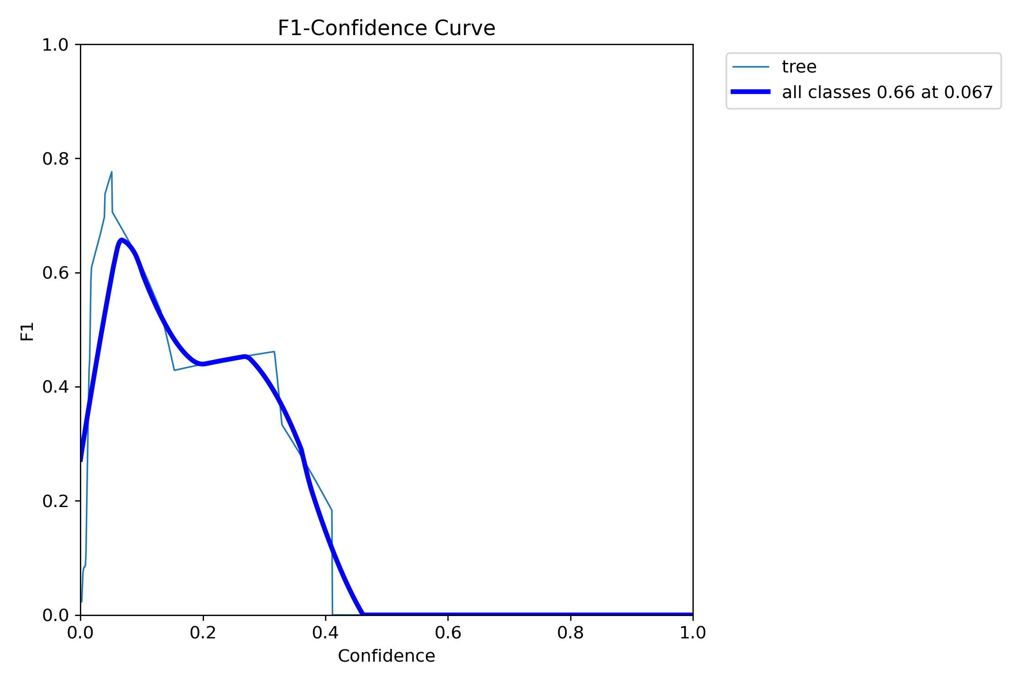
Work content

Slide 9
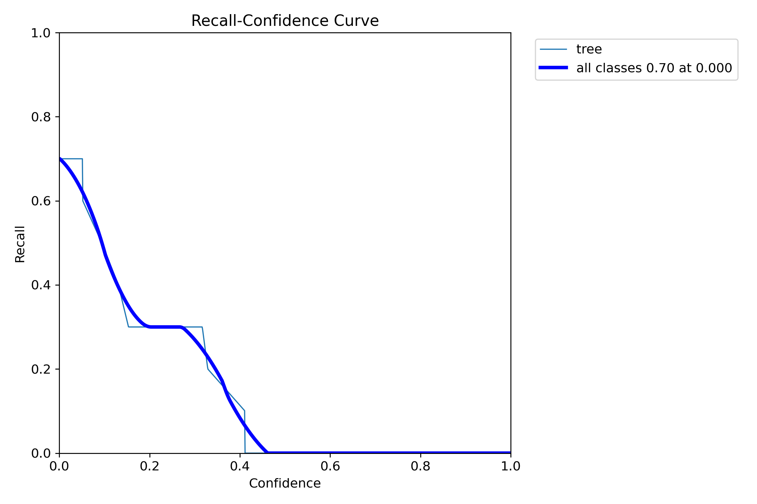
Work content

Slide 10
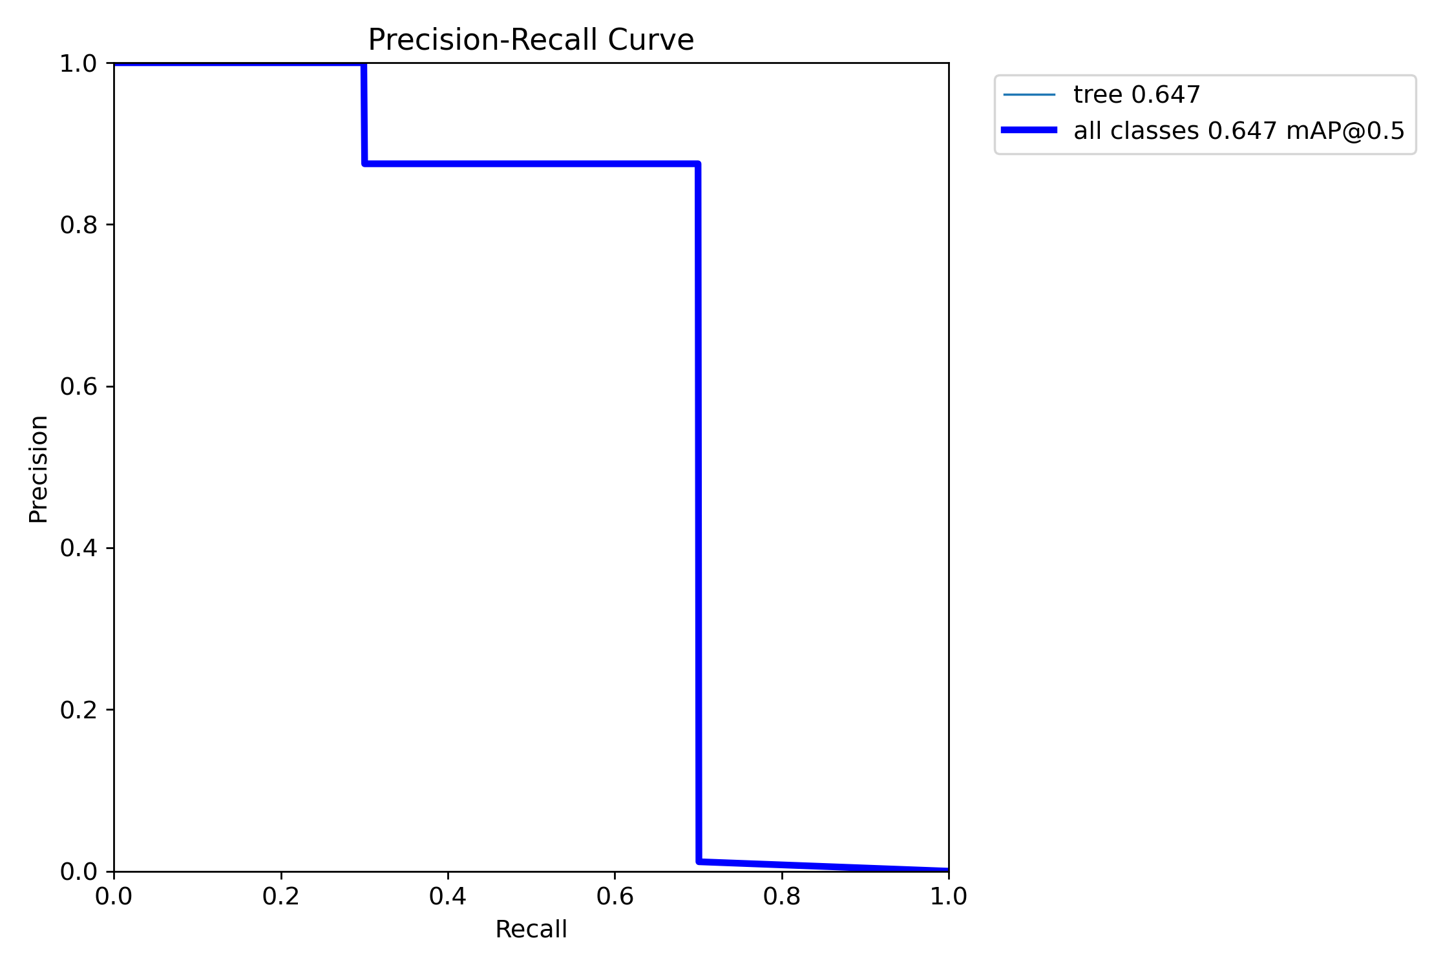
Work content

Slide 11
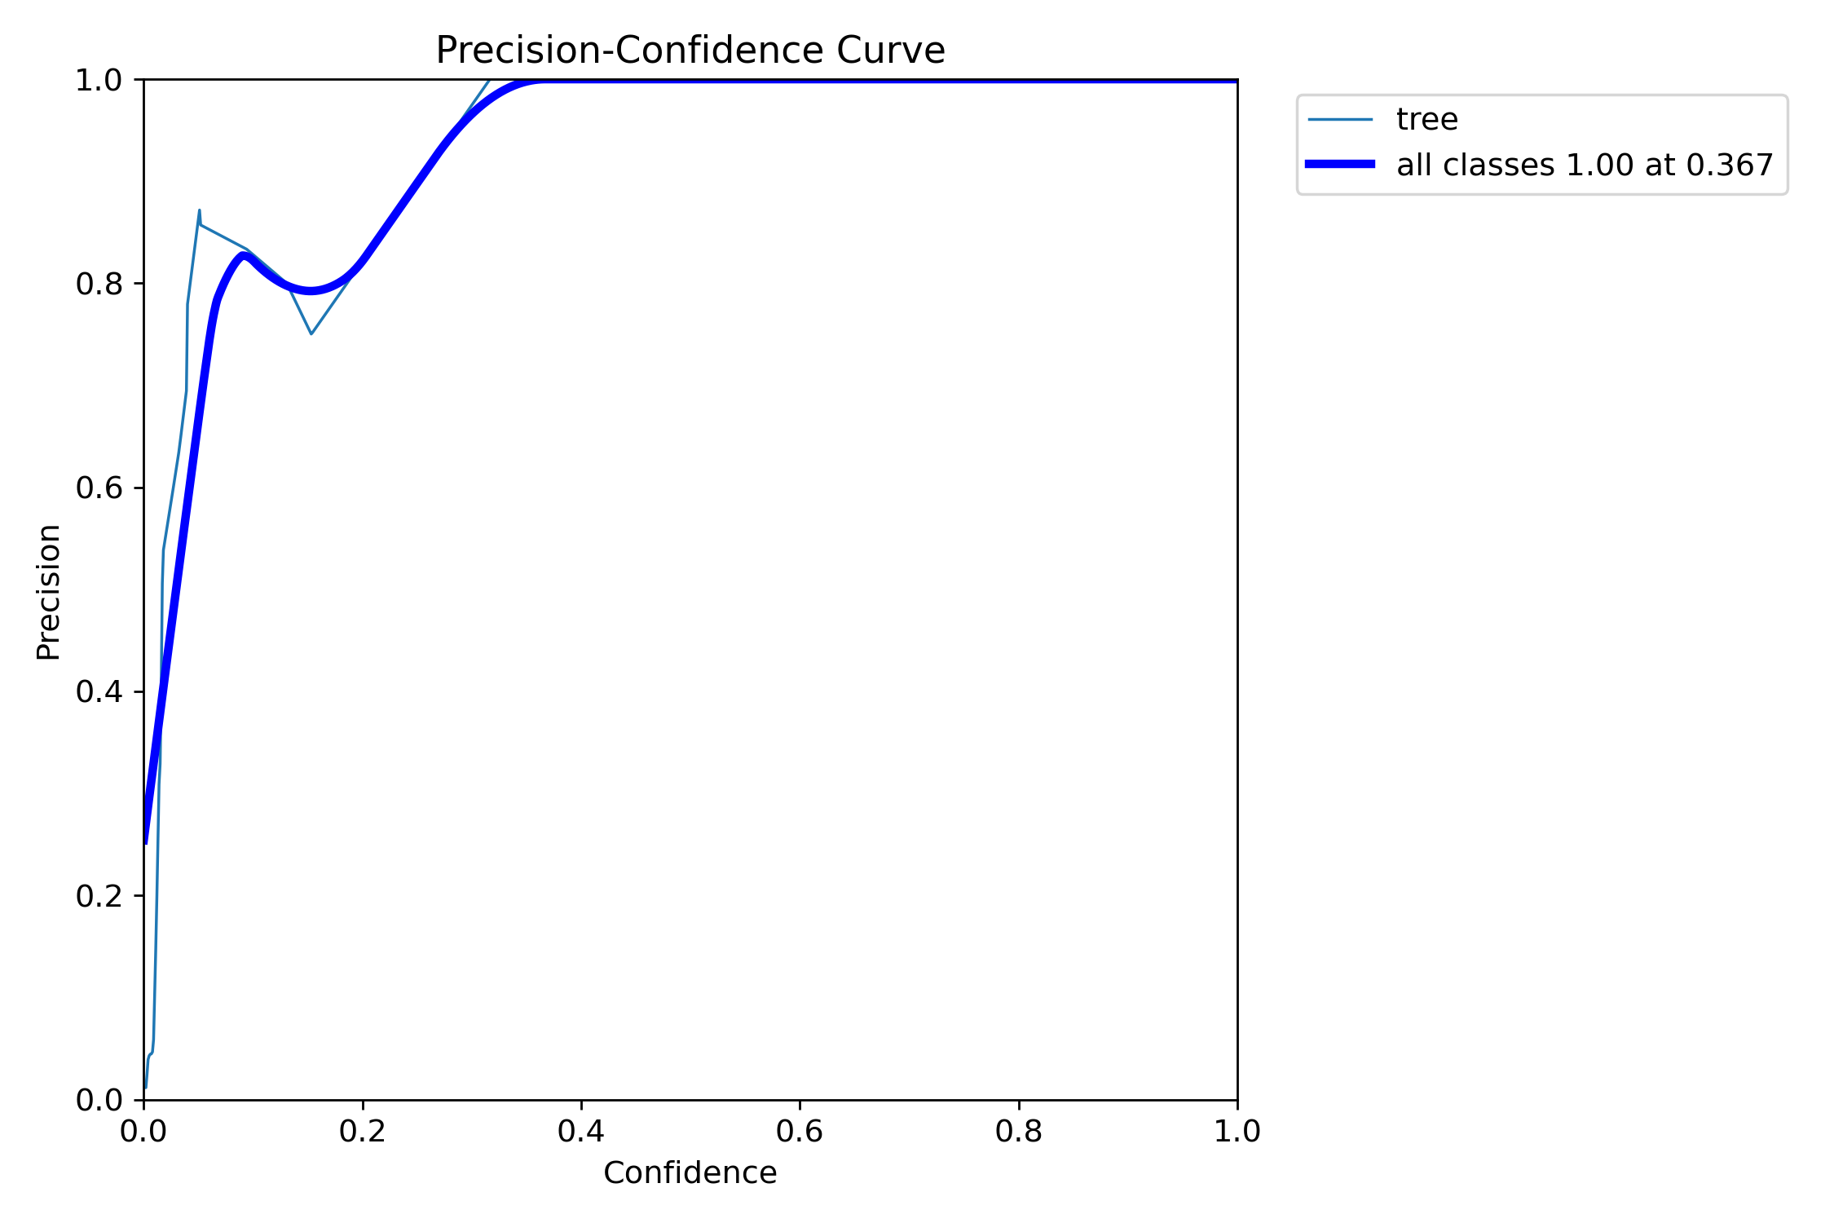
Work content

Slide 12
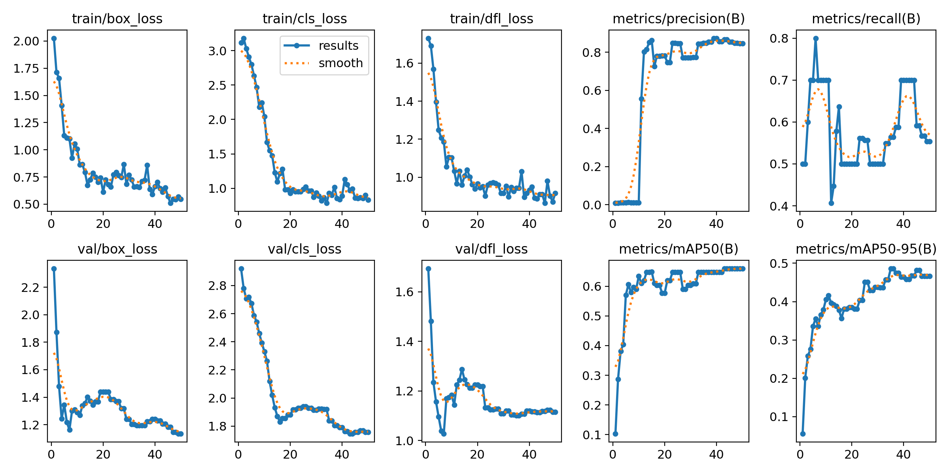
Work content

Slide 13
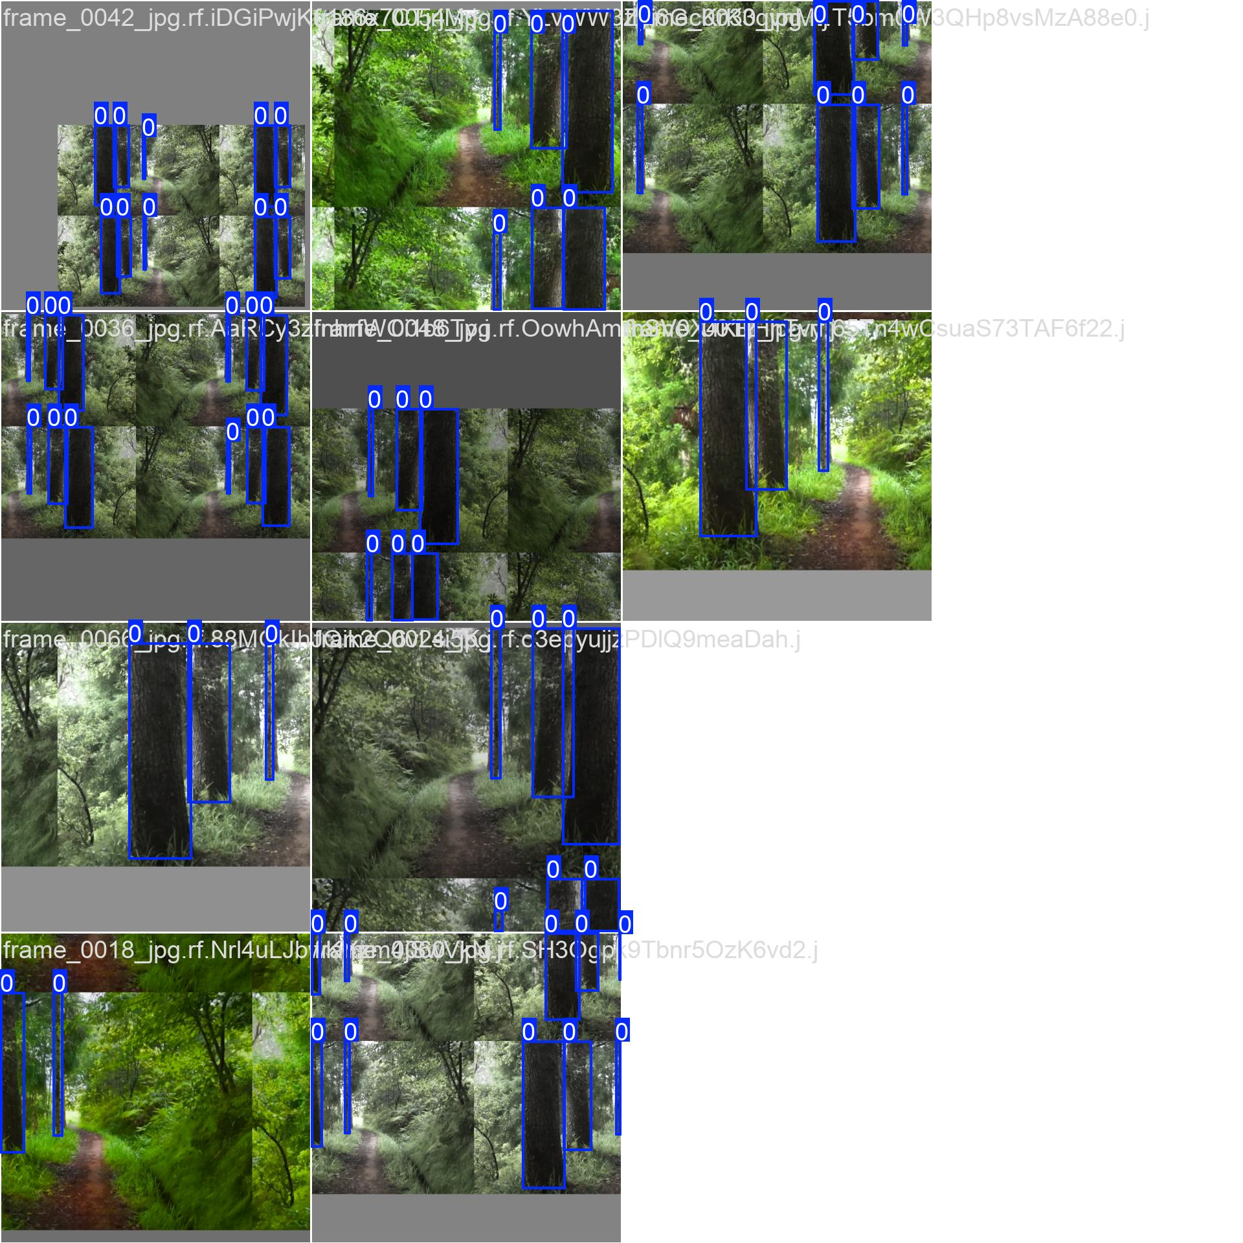
Work content

Slide 14
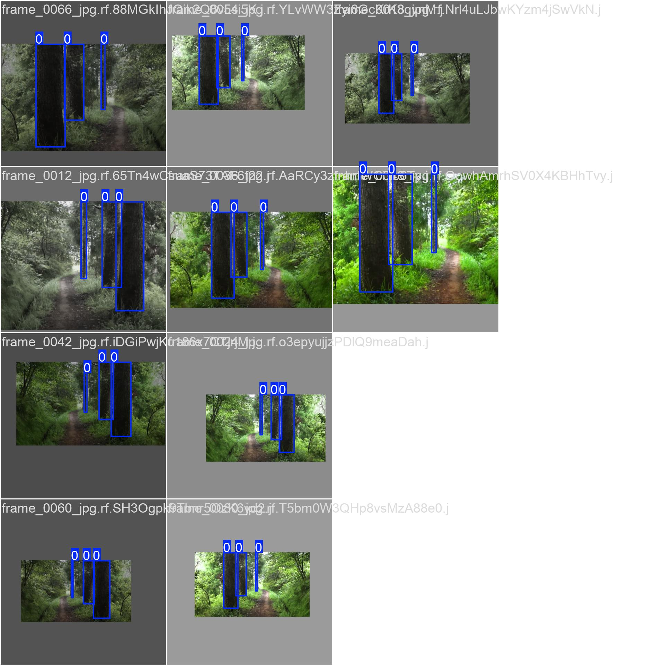
Work content

Slide 15
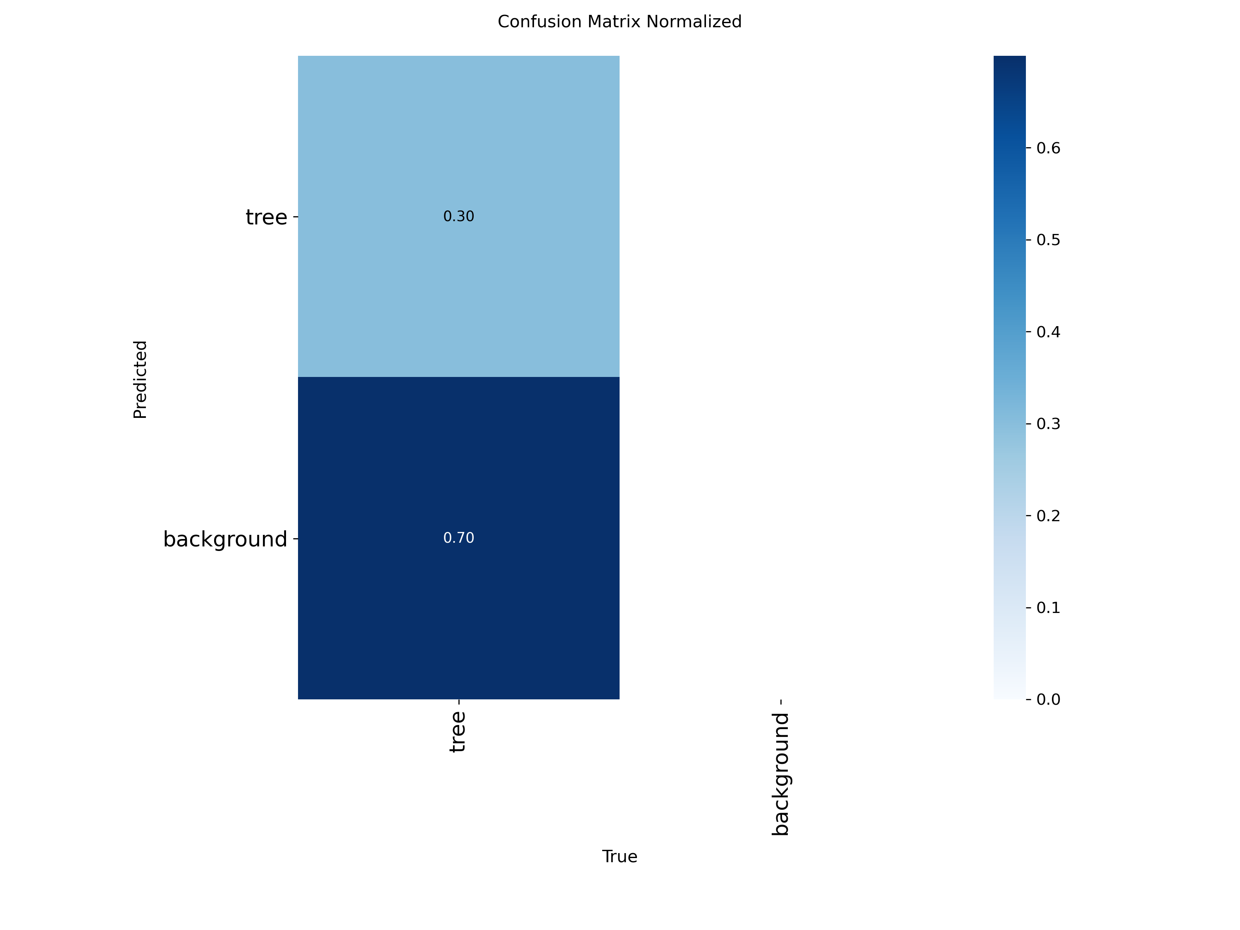
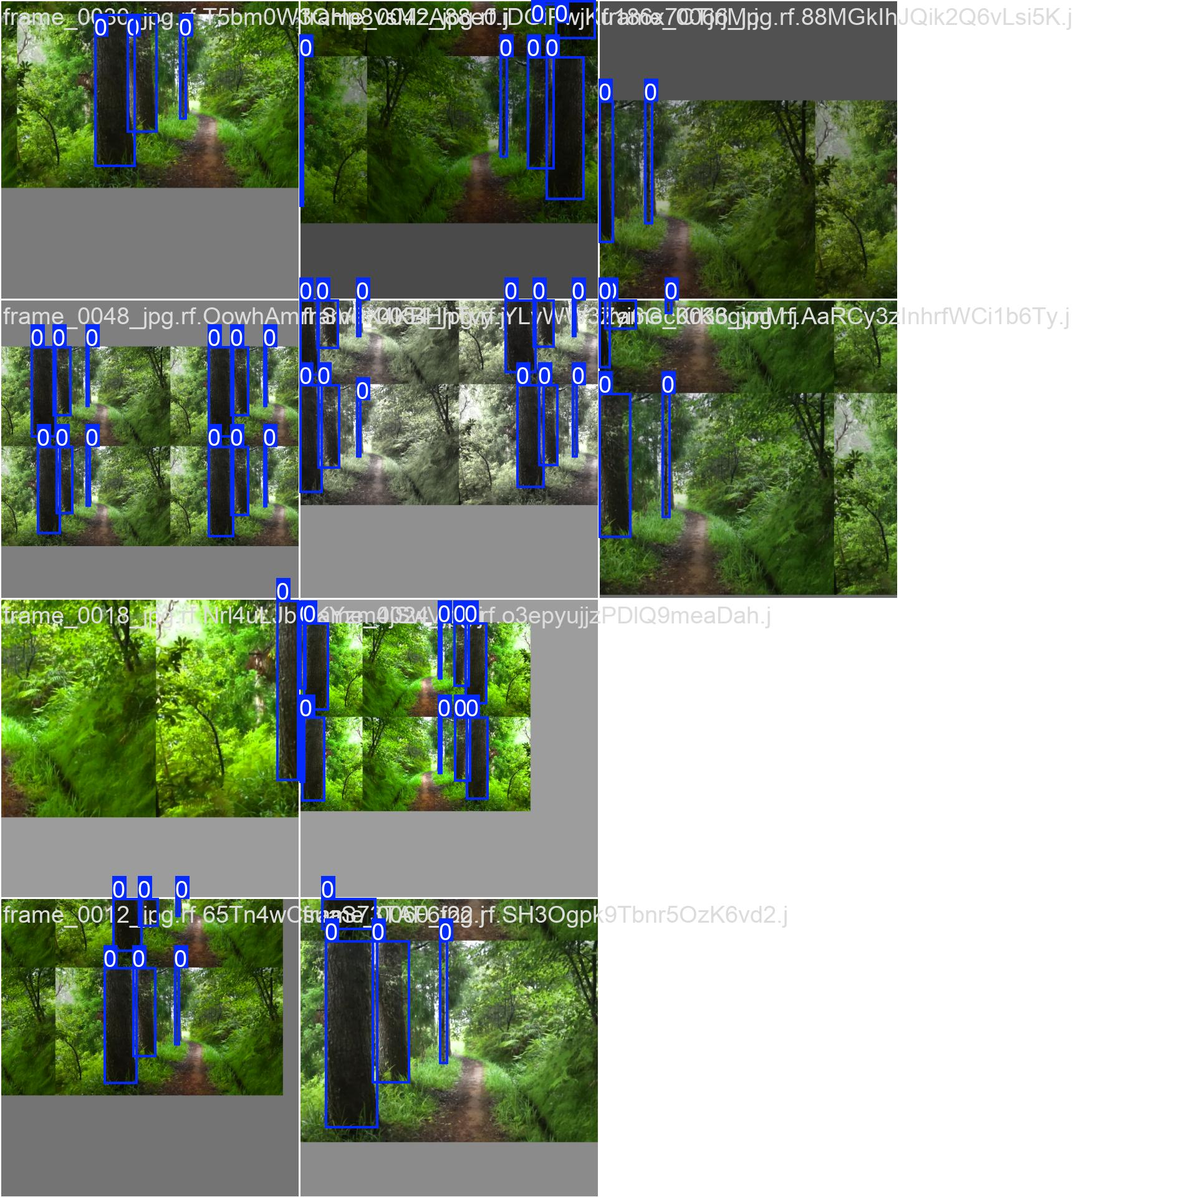
Work content

Slide 16
Work content
# class x_center y_center width height
cls_id = int(float(parts[0]))
x_center = float(parts[1])
y_center = float(parts[2])
width = float(parts[3])
height = float(parts[4])
# 3D maaping
# x = horizontal image position
# y = frame progression (walk direction)
# z = tree "height/strength" estimated from bbox height
x = (x_center - 0.5) * 20
y = frame_index * 1.5
z = height * 30
# Simple rule:
# smaller trees -> cut (green)
# larger trees -> keep (red)
decision = "cut" if height < 0.25 else "keep"
color = "green" if decision == "cut" else "red"
frame_count = 0
fps = 5
video_fps = cap.get(cv2.CAP_PROP_FPS)
frame_interval = int(video_fps / fps)
Im using 5 frames per second to get more information out from the video itself
Here you can see how my 3D map positions and the rule for the decision making

Slide 17
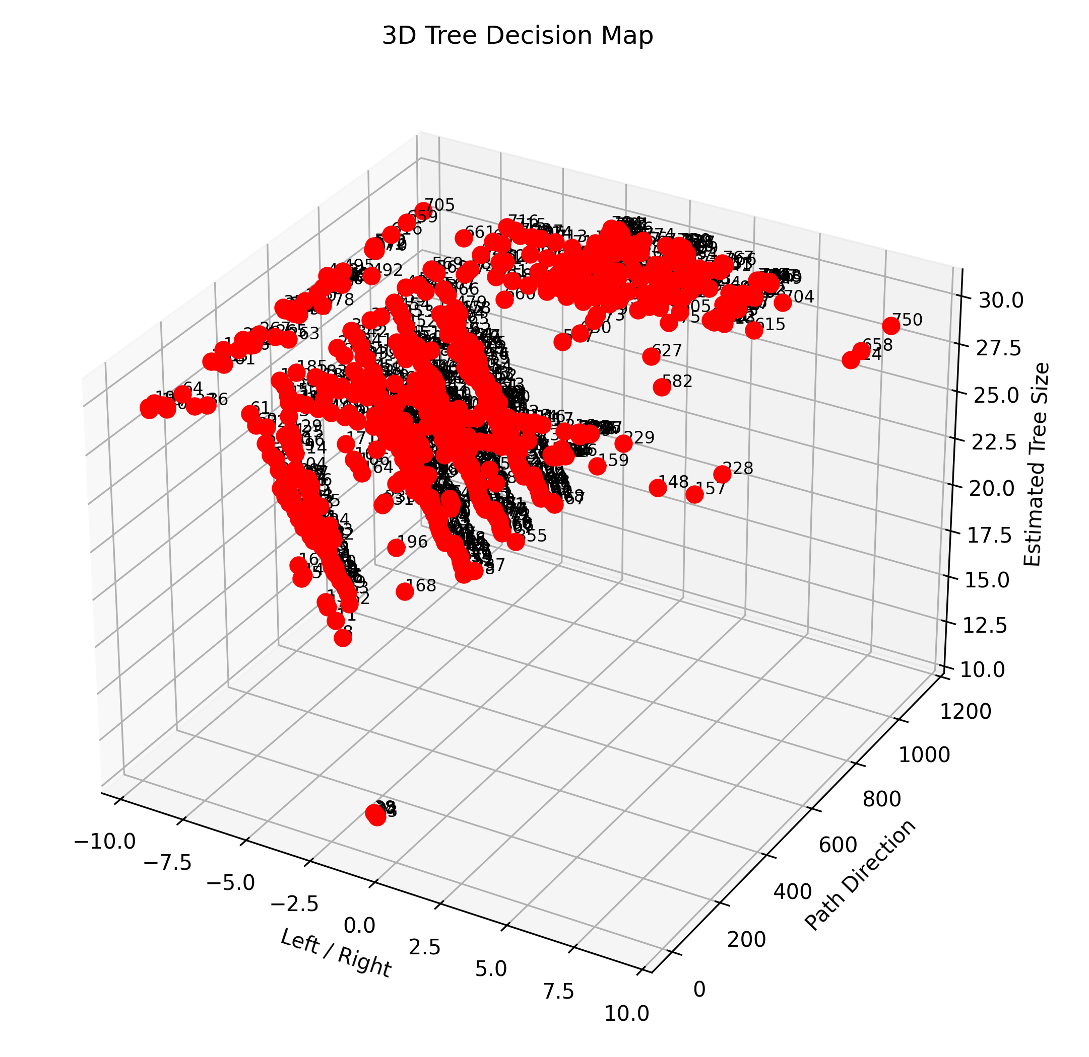
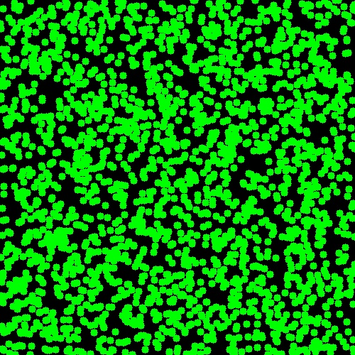
Work content

Slide 18
Results
Frame extratction successfully developed
Tree labeling dataset created
YOLOv8 model trained
Tree detection works on new frames
Prototype 2D and 3D map generated
Basic cut and keep logic implemented
Limitations
Small dataset reduces accuracy
No LiDAR or GPS integration yet
Mapping is approxmate , not real world precise

Slide 19
Conclusions
An AI based prototype for forest tree detection and decision support was developed
YOLOv8 can be used to detect trees from forest video footage
Detection results can be used for supporting and mapping a forest environment
Future improvements include LiDAR, GPS ,Larger Datasets , tracking and live mapping.

Slide 20
Estimation of progress timeline
Technical progress of the project itself - 80% completed
Documentation and thesis paper - 65% - 70% completed
Estimation finishing time - - in 160 working hours which is equal to a month
from today

Slide 21
Thank you for your attention! Please, your questions…

